Slide 1
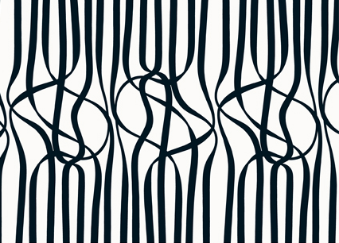
(Marimekko)
Rhythm
in art
Notes:
Rhythm is an interesting term.
Spelling – r-h-y-t-h-m
Refers to music
Rhythm you don’t hear but see; like music on paper
I’ve always taken art classes, and one of the principles of art they’ve taught us about is rhythm. San Diego Jewish Academy AP Studio Art suggests that rhythm is used in art to create movement and texture, and so becomes a part of basically every work of art.
According to the Free Dictionary, rhythm is “a regular or harmonious pattern created by lines, forms, and colors in painting, sculpture, and other visual arts,” and can be studied in sections of types of rhythm, how to create rhythm, and the effect rhythm has on a piece of artwork.

Slide 2
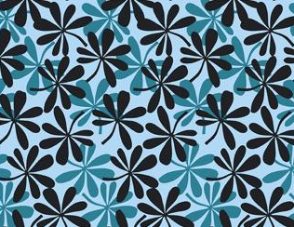
(Marimekko)
regular
rhythm
Notes:
Body
San Diego Jewish Academy AP Studio Art observes that there are many different types of rhythm, the most common of which are regular, flowing, and progressive.
Regular rhythm - repeated pattern

Slide 3
(Marimekko)
flowing
rhythm
Notes:
Flowing rhythm - creates movement

Slide 4
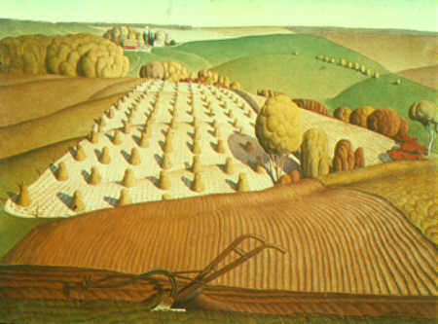
(Wood)
progressive
rhythm
Notes:
Progressive rhythm - sequence of objects in progression

Slide 5
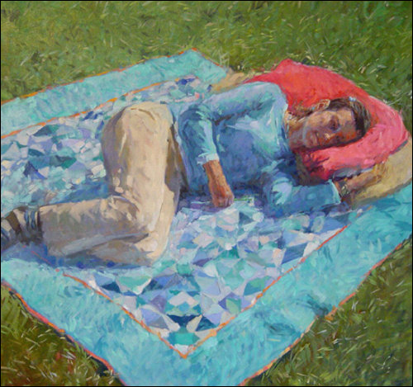
(Page)
rhythmic
marks
Notes:
Dianne Mize comments that various techniques are used to create rhythm
Rhythmic marks

Slide 6
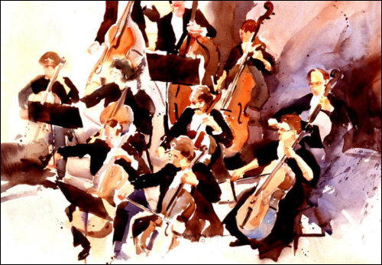
(Weaver)
repeating motifs
Notes:
Repeating motifs

Slide 7
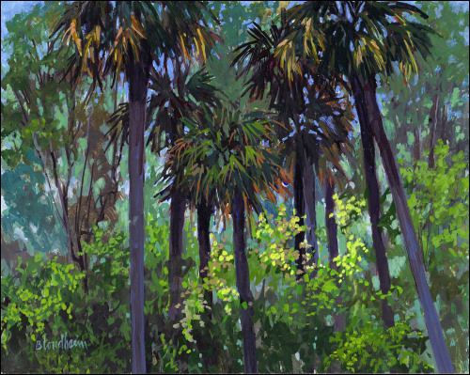
(Blondheim)
marks and motifs
Notes:
Marks and motifs

Slide 8
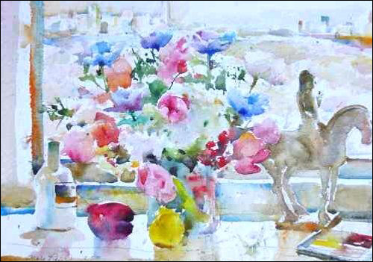
(Reid)
see the
movement
Notes:
Rhythm can have drastic effects on the way a piece of artwork is viewed.
Dianne Mize asserts - see the movement

Slide 9
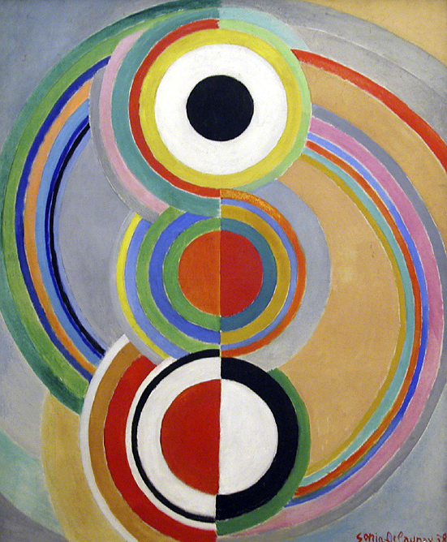
(Delaunay)
“visual beat”
Notes:
Shelley Esaak believes - “Visual beat”
If you could see the music
Jazz

Slide 10
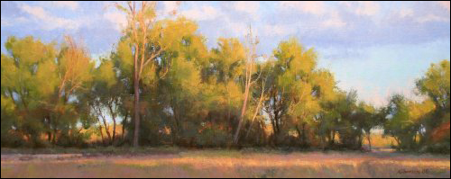
(Hanson)
unity
Notes:
Dianne Mize adds – unity
Marks, motifs, color, line, form
Combine → togetherness

Slide 11
Works Cited
Blondheim, Linda. Washington Oaks State Park Palms. N.d. Private collection. EmptyEasel. Web. 23 Oct. 2011. <http://emptyeasel.com/‌2009/‌02/‌17/‌rhythm-art-how-to-create-effective-visual-rhythm-through-marks-and-motifs/>.
Delaunay, Sonia. Rhythm. 1938. Art Blart. Web. 21 Oct. 2011. <http://artblart.wordpress.com/‌category/‌illustration/>.
- - -. Rhythm. 1938. Private collection. Art Blart. Web. 23 Oct. 2011. <http://artblart.wordpress.com/‌category/‌illustration/>.
Esaak, Shelley. “Rhythm.” About.com. The New York Times Co., 2011. Web. 21 Oct. 2011. <http://arthistory.about.com/‌cs/‌glossaries/‌g/‌r_rhythm.htm>.
Hanson, Marc. Raking Light. N.d. Private collection. EmptyEasel. Web. 23 Oct. 2011. <http://emptyeasel.com/‌2009/‌02/‌17/‌rhythm-art-how-to-create-effective-visual-rhythm-through-marks-and-motifs/>.
Marimekko. Hevoskastanja. N.d. Private collection. WriteDesign. Web. 23 Oct. 2011. <http://www.writedesignonline.com/‌resources/‌design/‌rules/‌rhythm-pattern.html>.
- - -. Matkalla Maalle. N.d. Private collection. WriteDesign. Web. 23 Oct. 2011. <http://www.writedesignonline.com/‌resources/‌design/‌rules/‌rhythm-pattern.html>.
- - -. Pelimanni. N.d. Private collection. WriteDesign. Web. 23 Oct. 2011. <http://www.writedesignonline.com/‌resources/‌design/‌rules/‌rhythm-pattern.html>.
Mize, Dianne. “Rhythm & Art: How to Create Effective Visual Rhythm through Marks and Motifs.” Empty Easel. EmptyEasel.com, 2011. Web. 21 Oct. 2011. <http://emptyeasel.com/‌2009/‌02/‌17/‌rhythm-art-how-to-create-effective-visual-rhythm-through-marks-and-motifs/>.
Page, Colin. Woman lying on picnic blanket. N.d. Private collection. EmptyEasel. Web. 23 Oct. 2011. <http://emptyeasel.com/‌2009/‌02/‌17/‌rhythm-art-how-to-create-effective-visual-rhythm-through-marks-and-motifs/>.

Slide 12
Works Cited (con’t)
Reid, Charles. Flowers with horse figurine. N.d. Private collection. EmptyEasel. Web. 23 Oct. 2011. <http://emptyeasel.com/‌2009/‌02/‌17/‌rhythm-art-how-to-create-effective-visual-rhythm-through-marks-and-motifs/>.
“Rhythm.” Def. 5b. TheFreeDictionary. Farlex, 2011. Web. 23 Oct. 2011. <http://www.thefreedictionary.com/‌rhythm>.
“San Diego Jewish Academy AP Studio Art.” WriteDesign. Ed. Znet. San Diego Jewish Acad., n.d. Web. 21 Oct. 2011. <http://www.writedesignonline.com/‌resources/‌design/‌rules/‌rhythm-pattern.html>.
Weaver, Pat. We’ve Got Rhythm. N.d. Private collection. EmptyEasel. Web. 23 Oct. 2011. <http://emptyeasel.com/‌2009/‌02/‌17/‌rhythm-art-how-to-create-effective-visual-rhythm-through-marks-and-motifs/>.
Wood, Grant. Fall Plowing. N.d. WriteDesign. Web. 23 Oct. 2011. <http://www.writedesignonline.com/‌resources/‌design/‌rules/‌rhythm-pattern.html>.
Notes:
Conclusion
According to the Free Dictionary, rhythm is “a regular or harmonious pattern created by lines, forms, and colors in painting, sculpture, and other visual arts,” and can be studied in sections of types of rhythm, how to create rhythm, and the effect rhythm has on a piece of artwork.
As a review:
Three types of rhythm -regular, flowing, and progressive
Rhythmic marks, repeating motifs, and marks and motifs create rhythm
Rhythm causes the viewer to see the movement, see the visual beat, and feel unity
You may still not know how to spell rhythm, but now you know that it doesn’t apply only to music – it relates to art as well.

